Slide 1

Software Engineering Team Project

Slide 2

Team Lead: Andrew McKissick
Devin Ritter, Tellon Smith, Johann Redhead, Anderson Nwammadi

Slide 3
Overview
What is our project?
Team Organization
Diagrams
Development Tools

Slide 4
What is Our Project? Card Services: Wells Fargo
Customer
Dr. Terry Griffin, Assistant Professor at Midwestern State University
Goals
Redesign user interface
Enhance user productivity
Added security features

Slide 5
Project’s Functional Requirements
Admin must be able to create, delete, and edit users
User must be able to create, edit, and delete cards.
User must be able to upload and crop students’ pictures

Slide 6
Project’s Functional Requirements Cont’d
User must be able to browse and search cards
User must be able to generate a file to send to Wells Fargo

Slide 7
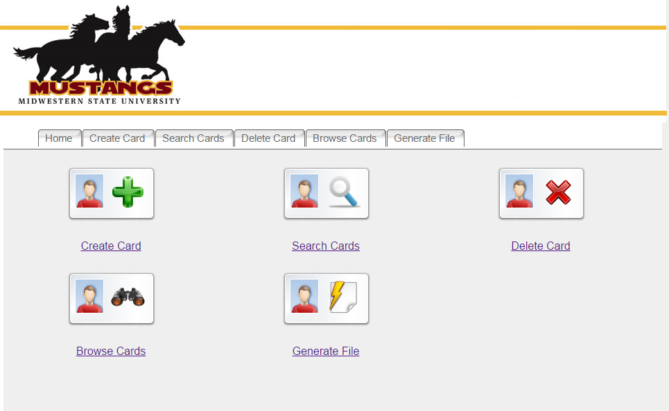
Previous Homepage

Slide 8
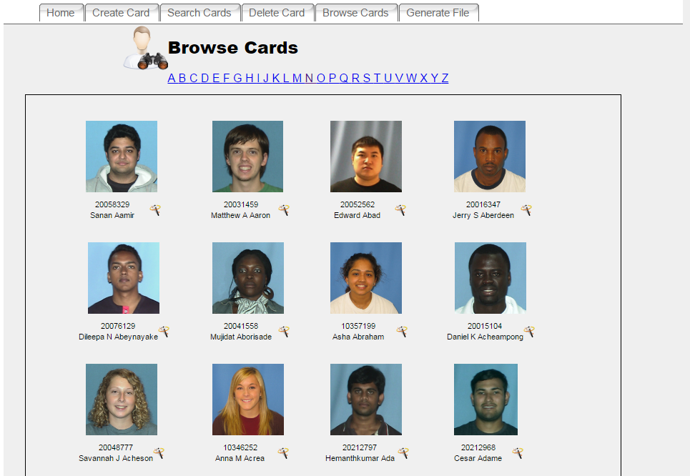
Previous Browse Cards Page

Slide 9
*Initial Proposed < >Page Put new screenshots plz

Slide 10
*Initial Proposed < >Page Put new screenshots plz

Slide 11
*Initial Proposed < >Page Put new screenshots plz

Slide 12

Team Organization Communication

Slide 13
Team Organization Communication
What is Slack?
Cross-platform application
Individual or group chat
What did we use Slack for?
General communication
Suggestions on works
Coordination of assignments and deadlines

Slide 14


Team Organization File Management

Slide 15
Team Organization File Management
What is GitHub?
Git repository hosting service
Web-based graphical interface
Control and collaboration features
What did we use GitHub for?
Open storage for files
Upload and download individual works

Slide 16
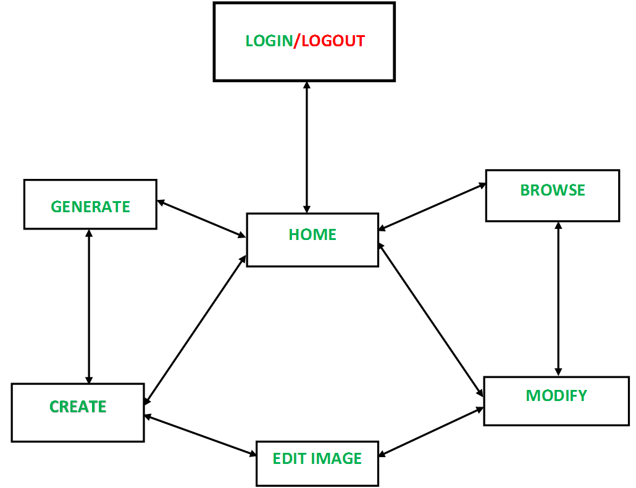
Diagrams Navigation

Slide 17
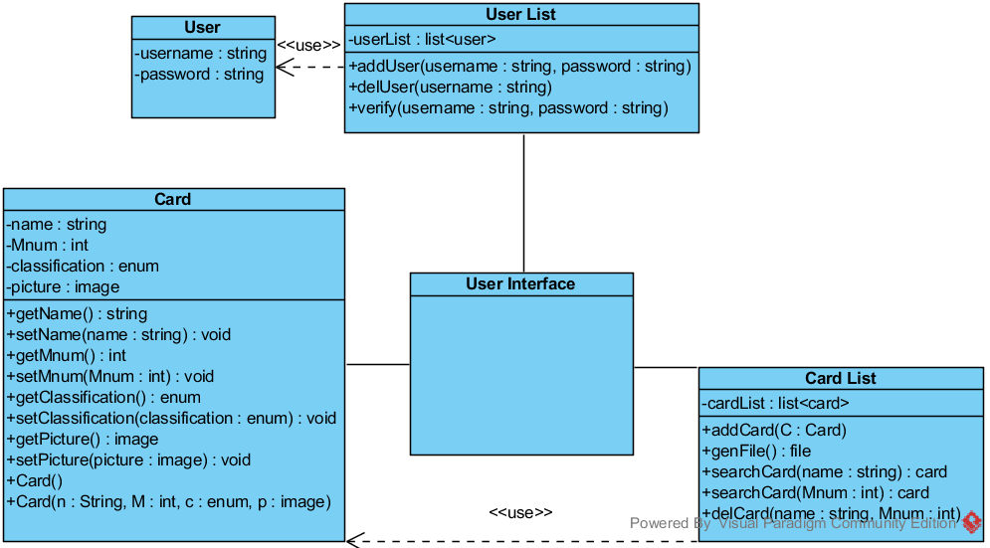
Diagrams Class

Slide 18
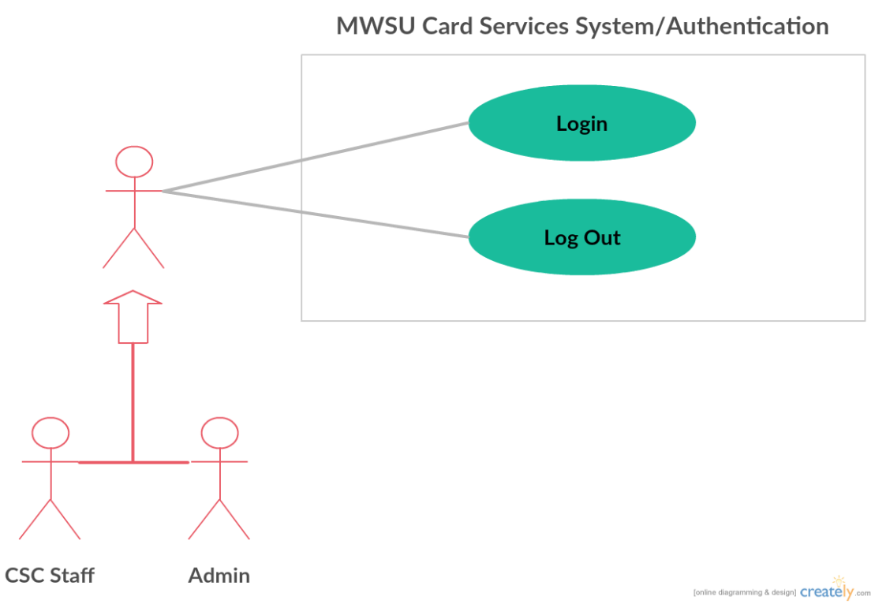
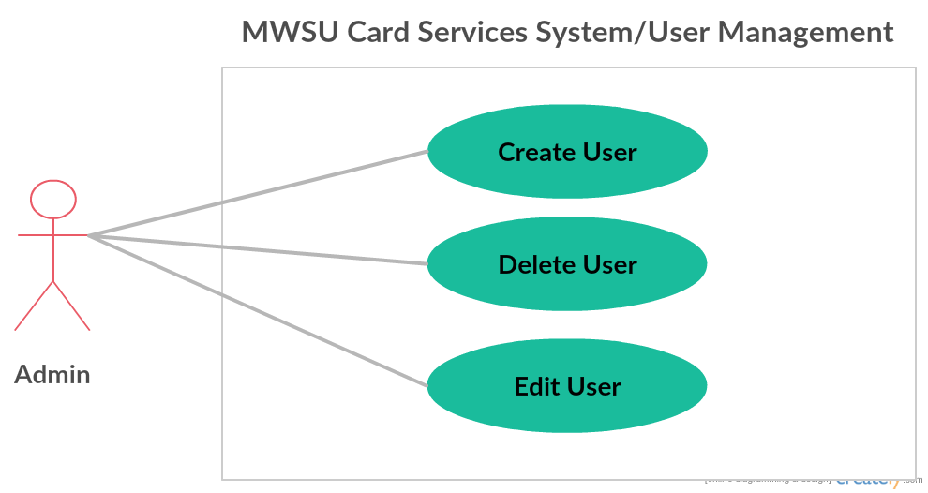
Diagrams Use Case

Slide 19
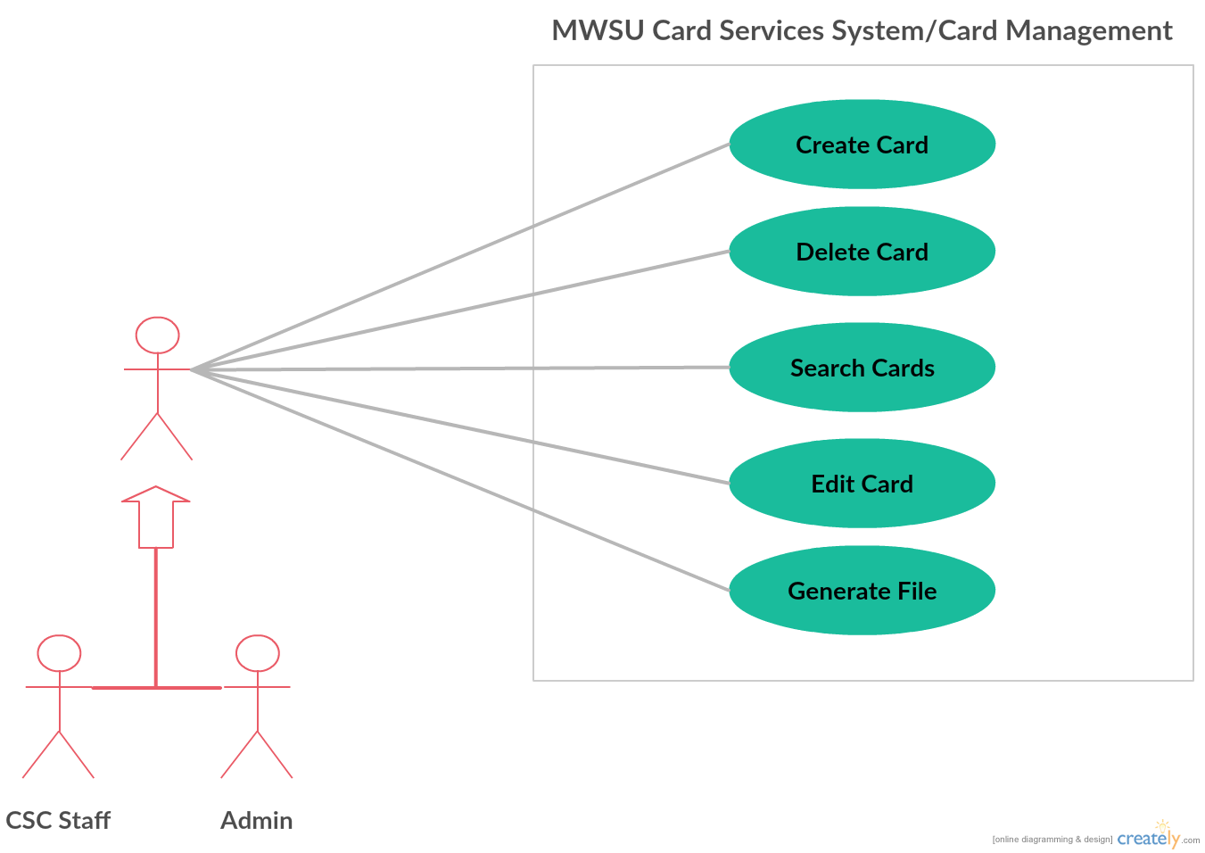
Diagrams Use Case

Slide 20
Development Tools Visual Paradigm
What is Visual Paradigm?
System modeling software
What we used it for
Create diagrams

Slide 21
Development Tools XAMPP
What is it XAMPP?
Local web hosting tool
*What we used it for
Create local server

Slide 22
Development Tools Notepad++
What is Notepad++?
A text editor
Extensive plugin library
What we used it for
Write & Edit code

Slide 23
Thank You! Questions?
References
Kung, David, Object-oriented Software Engineering: An Agile Unified Methodology. New York, NY: McGraw-Hill, 2013. Print.
XAMPP. (n.d.). Retrieved March 01, 2017, from https://www.apachefriends.org/index.html
Visual Paradigm. (n.d.). Retrieved March 01, 2017, from https://www.visual-paradigm.com/

